Slide 1

Magic Power Curves
Frederick Pletz
Regis University | Professor Hart
MSDS 692 Data Science Practicum

Slide 2
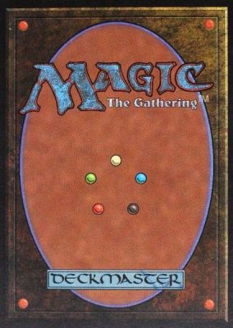
Outline
Background
Project Goals
Analytic Process
Findings
Future Research
Conclusion
Notes:
Image Citation: https://guildhall.ro/game-collection/magic-the-gathering/

Slide 3
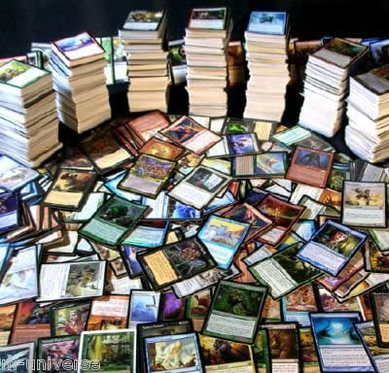
Background: What is Magic the Gathering (MtG)
Trading Card Game
Released in 1993
Complex rules
Cost (mana)
Power/Toughness
Abilities
Over 20,000 unique cards
Color Wheel
Notes:
Image Citation: https://www.amazon.com/Magic-Gathering-Uncommon-DUPLICATES-collection/dp/B00LXX682M

Slide 4
Project Goals & Methods
Project Summary: Identify power curve for MtG cards and identify meta trends in power curve over time.
Data Source: MTGJSON website – contains multi-format files of MtG card data (mtgjson.com)
Data Cleaning: power-curve confined to “simpler” cards
Creatures
Fixed power/toughness
Code-word Abilities Only

Slide 5
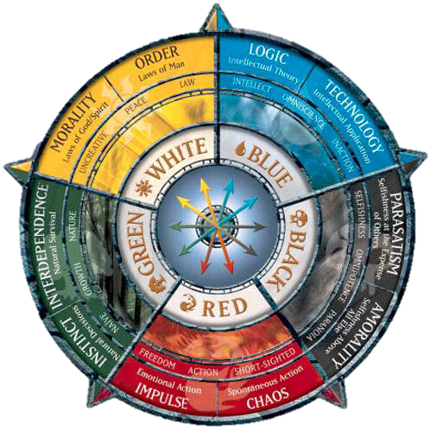
Analysis Process
Data Cleaning
Data Exploration in Excel and RapidMiner
Data Modeling in R
Decision Tree
General Linear Model
Color Wheel Word Cloud
Notes:
Image Citation: https://mtg.fandom.com/wiki/File:Color_Wheel.jpg

Slide 6
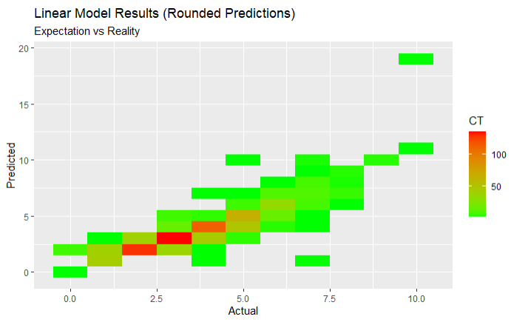
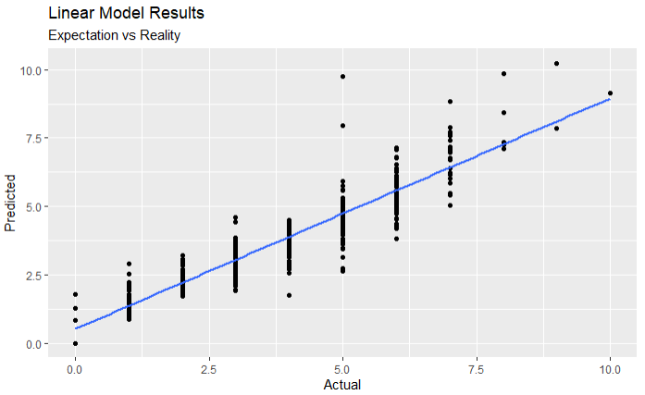
Findings (General Linear Model)

Slide 7
Findings (Significant Interaction)
Estimate Std. Error t value Pr(>|t|)
coloredManaCost -0.18860 0.01819 -10.367 < 2e-16 ***
power 0.62213 0.01329 46.811 < 2e-16 ***
toughness 0.46340 0.01252 37.006 < 2e-16 ***
rarity_common 0.19143 0.04397 4.354 1.41e-05 ***
rarity_mythic -2.75861 0.32082 -8.599 < 2e-16 ***
rarity_rare -0.34062 0.06934 -4.912 9.79e-07 ***
text_afterlife2 1.34350 0.47962 2.801 0.005144 **
text_amplify1 1.85484 0.39247 4.726 2.46e-06 ***
text_flying 0.74037 0.03898 18.994 < 2e-16 ***
text_amplify2 2.12616 0.76010 2.797 0.005207 **
text_provoke 1.18993 0.34006 3.499 0.000477 ***
text_haste 0.53886 0.06559 8.216 3.86e-16 ***
text_banding 0.39751 0.11684 3.402 0.000683 ***
text_firststrike 0.62360 0.06678 9.339 < 2e-16 ***
text_islandwalk 0.81900 0.15351 5.335 1.07e-07 ***
text_bloodthirst2 1.00896 0.21807 4.627 3.97e-06 ***
text_bloodthirst3 1.72866 0.39207 4.409 1.10e-05 ***
text_bushido2 1.50330 0.48080 3.127 0.001795 **
text_cascade 0.99211 0.17295 5.736 1.12e-08 ***
text_vigilance 0.31525 0.06157 5.120 3.37e-07 ***
text_convoke 1.24018 0.18037 6.876 8.34e-12 ***
text_hexproof 0.51217 0.13339 3.840 0.000127 ***
text_defender -0.60808 0.08685 -7.001 3.51e-12 ***
text_exalted 0.61565 0.17650 3.488 0.000498 ***
text_reach 0.36755 0.08188 4.489 7.60e-06 ***
text_delve 1.88771 0.24372 7.745 1.54e-14 ***
text_devour3 1.95794 0.48178 4.064 5.02e-05 ***
text_doublestrike 1.30269 0.12711 10.248 < 2e-16 ***
text_undying 0.91447 0.25827 3.541 0.000409 ***
text_fabricate1 0.86741 0.21569 4.022 6.01e-05 ***
text_fabricate2 2.55224 0.48183 5.297 1.31e-07 ***
text_fear 1.19110 0.17352 6.864 9.04e-12 ***
text_soulshift5 1.85131 0.30675 6.035 1.91e-09 ***
text_infect 0.55177 0.19700 2.801 0.005148 **
text_modular4 6.23127 0.68186 9.139 < 2e-16 ***
text_flash 0.74427 0.11263 6.608 5.05e-11 ***
text_fading3 -1.36500 0.30025 -4.546 5.81e-06 ***
text_soulshift4 1.37434 0.33939 4.050 5.34e-05 ***
text_swampwalk 0.72962 0.10329 7.064 2.27e-12 ***
text_horsemanship 1.55590 0.21785 7.142 1.31e-12 ***
text_rampage1 1.20412 0.34067 3.535 0.000418 ***
text_improvise 0.92040 0.30853 2.983 0.002889 **
text_intimidate 0.81973 0.24080 3.404 0.000678 ***
text_soulshift6 2.20669 0.68934 3.201 0.001392 **
text_modular3 4.66345 0.67796 6.879 8.18e-12 ***
text_rampage2 1.68804 0.26543 6.360 2.53e-10 ***
text_rampage3 2.32280 0.67895 3.421 0.000637 ***
text_vanishing4 -1.22756 0.41570 -2.953 0.003186 **
text_soulshift7 1.71888 0.67832 2.534 0.011357 *
text_sunburst 3.29326 0.48020 6.858 9.42e-12 ***
text_soulshift8 1.78136 0.68268 2.609 0.009143 **
text_vanishing2 -3.09184 0.67905 -4.553 5.62e-06 ***
text_bushido5 3.60450 0.72168 4.995 6.44e-07 ***
Signif. codes: 0 ‘***’ 0.001 ‘**’ 0.01 ‘*’ 0.05 ‘.’ 0.1 ‘ ’ 1
Null deviance: 5995.24 on 1985 degrees of freedom
Residual deviance: 864.81 on 1890 degrees of freedom

Slide 8
Findings (Non-significant Interaction)
Estimate Std. Error t value Pr(>|t|)
text_trample 0.15666 0.07826 2.002 0.045435 *
text_assist NA NA NA NA
text_battlecry 0.65926 0.39146 1.684 0.092325 .
text_bloodthirst1 0.19059 0.21715 0.878 0.380211
text_flanking 0.12978 0.27851 0.466 0.641273
text_lifelink 0.10932 0.08830 1.238 0.215870
text_menace 0.30323 0.13307 2.279 0.022793 *
text_bloodthirst6 NA NA NA NA
text_bushido1 0.24250 0.27741 0.874 0.382147
text_devour2 0.99492 0.70138 1.419 0.156202
text_indestructible 0.39634 0.24038 1.649 0.099356 .
text_afterlife1 0.26524 0.39263 0.676 0.499408
text_renown1 -0.05650 0.21568 -0.262 0.793370
text_unleash 0.34179 0.16684 2.049 0.040633 *
text_evolve 0.47895 0.27823 1.721 0.085343 .
text_extort 0.19218 0.39551 0.486 0.627095
text_shroud 0.14551 0.14145 1.029 0.303748
text_wither 0.39670 0.20400 1.945 0.051978 .
text_devoid -0.43726 0.67758 -0.645 0.518795
text_ingest NA NA NA NA
text_devour1 -0.12944 0.48224 -0.268 0.788408
text_prowess 0.16875 0.14408 1.171 0.241659
text_dredge3 0.59545 0.33918 1.756 0.079326 .
text_fading2 NA NA NA NA
text_persist 0.65571 0.28166 2.328 0.020018 *
text_forestwalk 0.14402 0.12909 1.116 0.264701
text_partner -1.69202 0.70014 -2.417 0.015757 *
text_mentor 0.28865 0.27797 1.038 0.299200
text_ripple4 0.52078 0.67970 0.766 0.443658
text_melee 0.46417 0.48066 0.966 0.334330
text_modular1 0.79326 0.34087 2.327 0.020063 *
text_phasing -0.95598 0.48004 -1.991 0.046575 *
text_soulshift3 0.92037 0.47934 1.920 0.055000 .
rarity_special -0.19595 0.26532 -0.739 0.460278
rarity_uncommon NA NA NA NA
text_afflict1 -0.31902 0.67699 -0.471 0.637531
text_renown2 0.31780 0.48106 0.661 0.508925
text_skulk 0.43647 0.40057 1.090 0.276023
text_riot 0.71938 0.48366 1.487 0.137084
text_shadow -0.23349 0.67732 -0.345 0.730339
text_mountainwalk 0.24853 0.16670 1.491 0.136174
text_afflict2 -0.02437 0.69183 -0.035 0.971904
text_dethrone 1.16881 0.68947 1.695 0.090195 .
text_modular2 NA NA NA NA
text_rampage4 NA NA NA NA
text_myriad -0.12574 0.30674 -0.410 0.681920
text_graft1 0.85204 0.48037 1.774 0.076268 .
text_changeling -0.01345 0.25724 -0.052 0.958303
text_deathtouch 0.19375 0.09291 2.085 0.037164 *
Signif. codes: 0 ‘***’ 0.001 ‘**’ 0.01 ‘*’ 0.05 ‘.’ 0.1 ‘ ’ 1
Null deviance: 5995.24 on 1985 degrees of freedom
Residual deviance: 864.81 on 1890 degrees of freedom

Slide 9
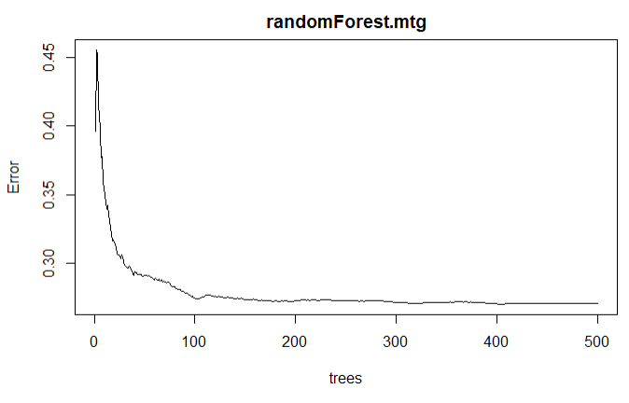
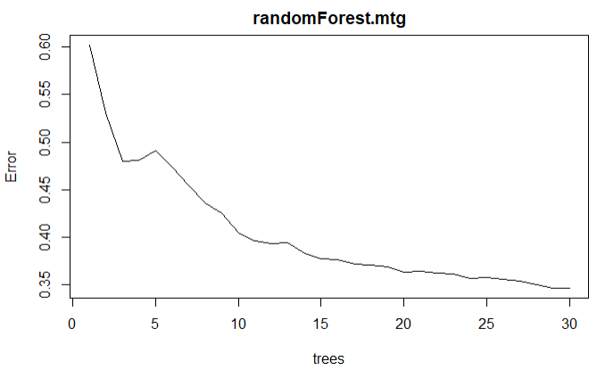
Findings (Random Forest)

Slide 10
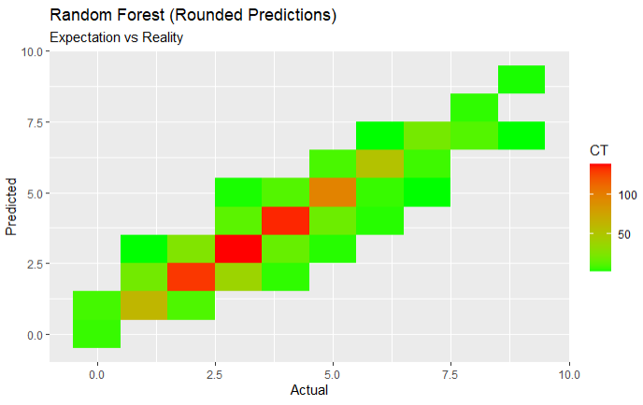
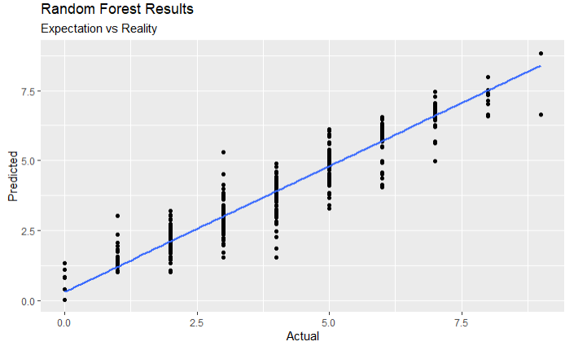
Findings (Random Forest)

Slide 11
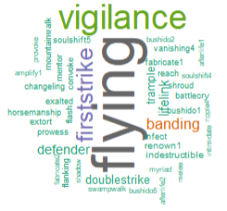
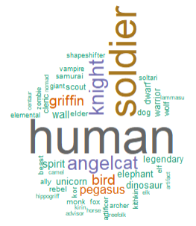
Findings (Color Wheel White)

Slide 12

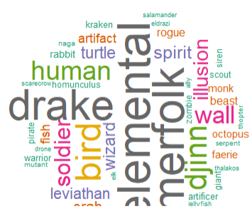
Findings (Color Wheel Blue)

Slide 13
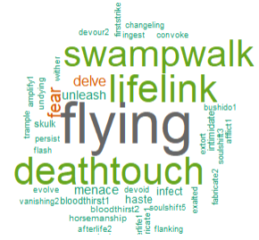
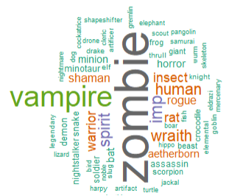
Findings (Color Wheel Black)

Slide 14
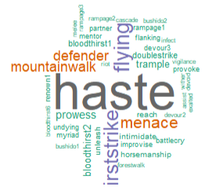
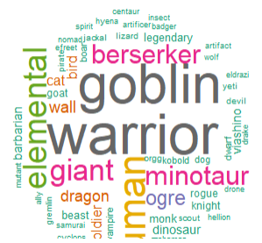
Findings (Color Wheel Red)

Slide 15
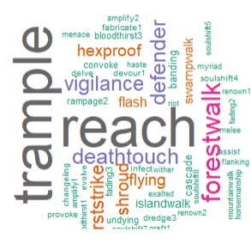
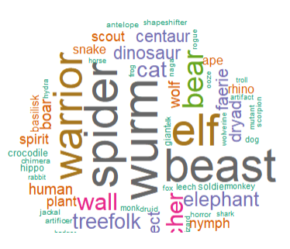
Findings (Color Wheel Green)

Slide 16
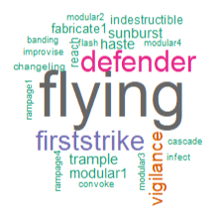
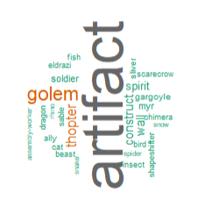
Findings (Color Wheel Artifact)

Slide 17
Future Research
Reduce Selection Bias
Evaluate non-creature
Non-keyword to keyword conversion where possible
Add Timeline Evaluation
GLM by release over time
Competition Deck Analysis
Evaluate cards in deck against power curve
Evaluation of “Outside Power Curve Cards”
Identify meta trends for powerful or useless cards

Slide 18
Conclusion
It is possible to calculate power curve for MtG
Power Curve is relative, there are observable instances of cards evaluating above and below power curve
Color Wheel supported by creature type and keyword usage

Slide 19
Questions?

